Slide 1
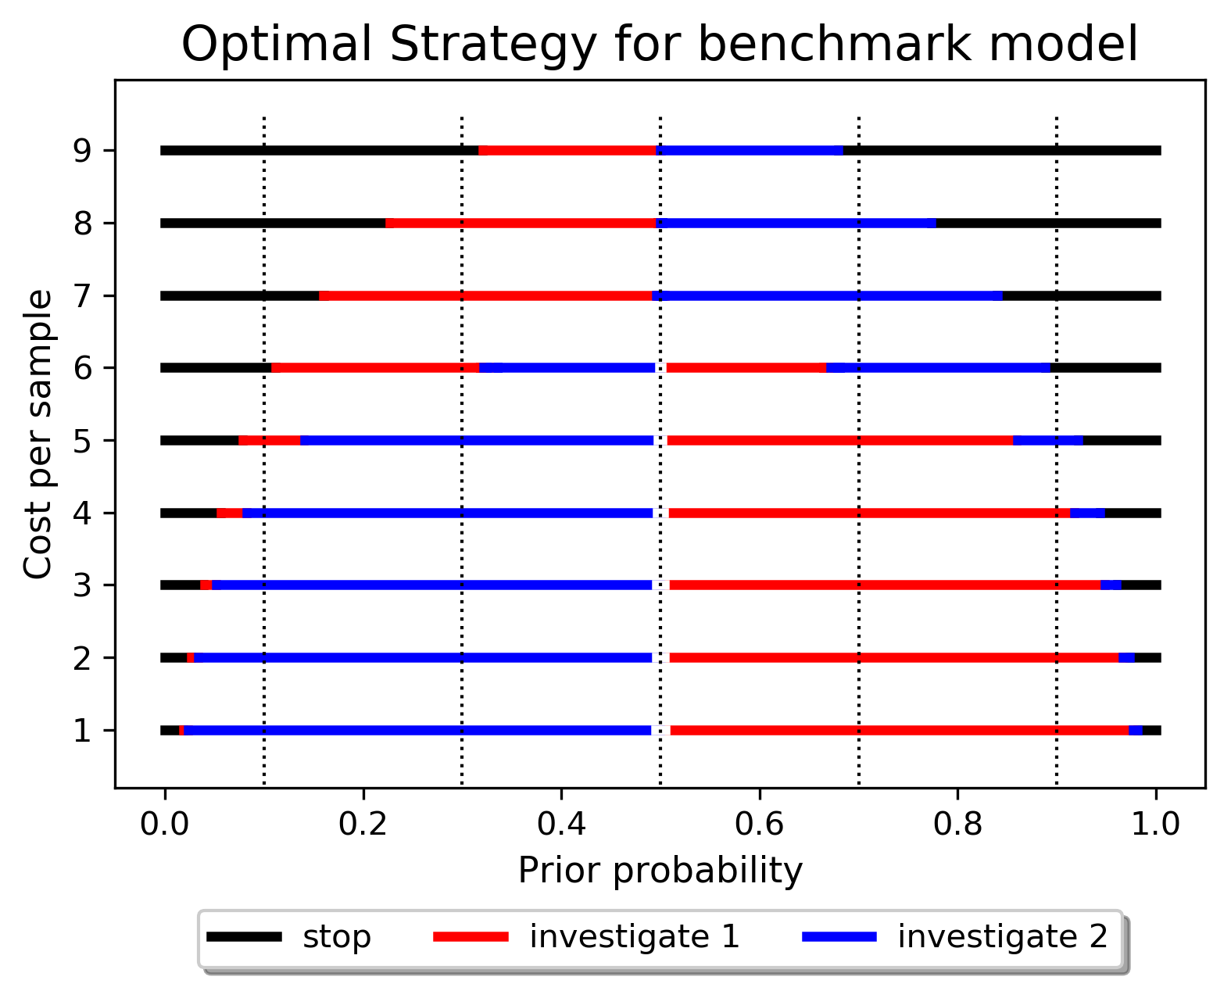
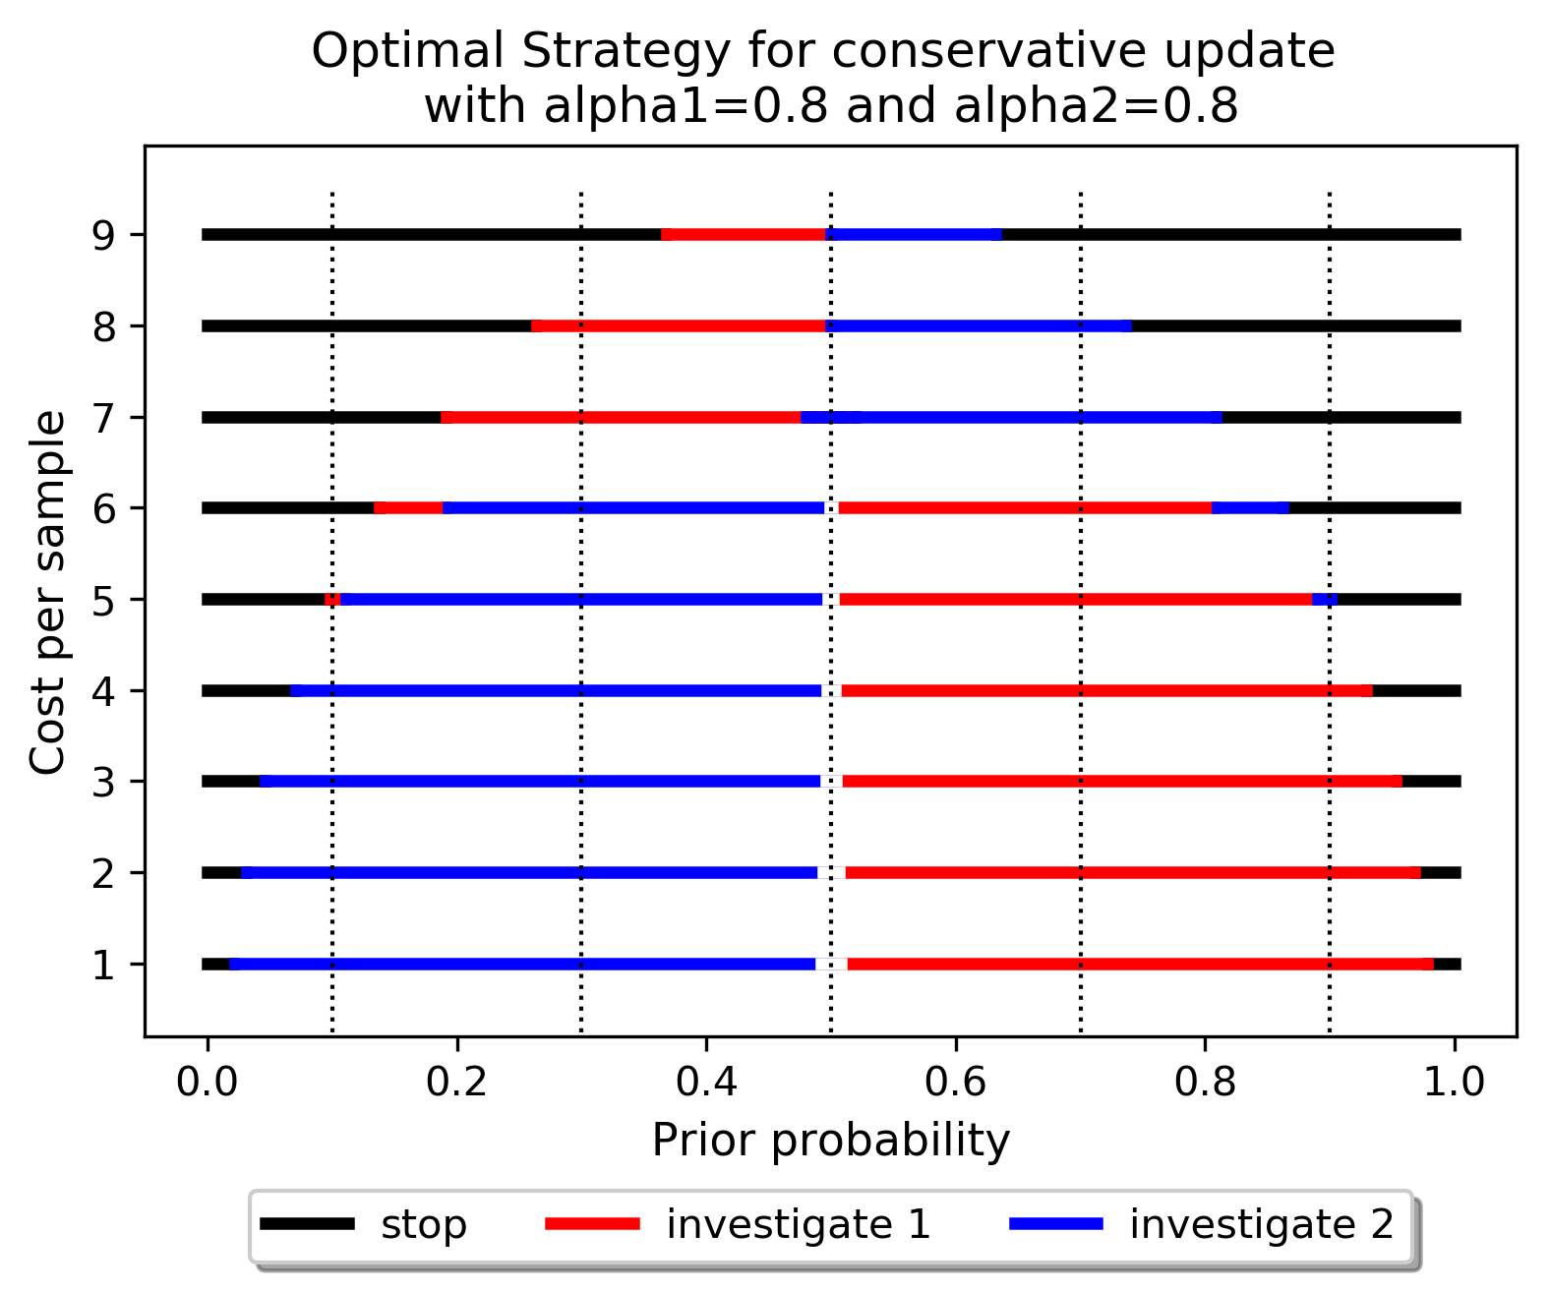
alpha1 = 0.8, alpha2 = 0.8, stop cost = 0

Slide 2
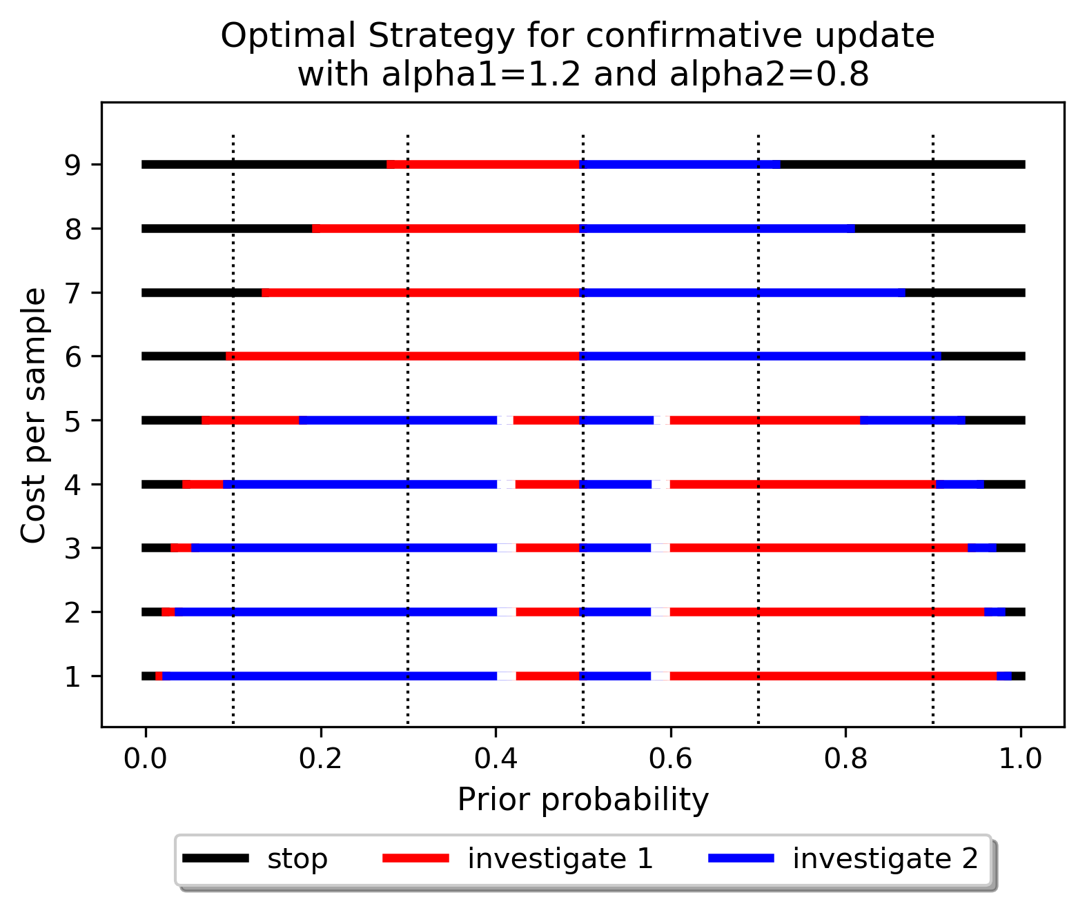
alpha1 = 1.2, alpha2 = 0.8, stop cost = 0

Slide 3
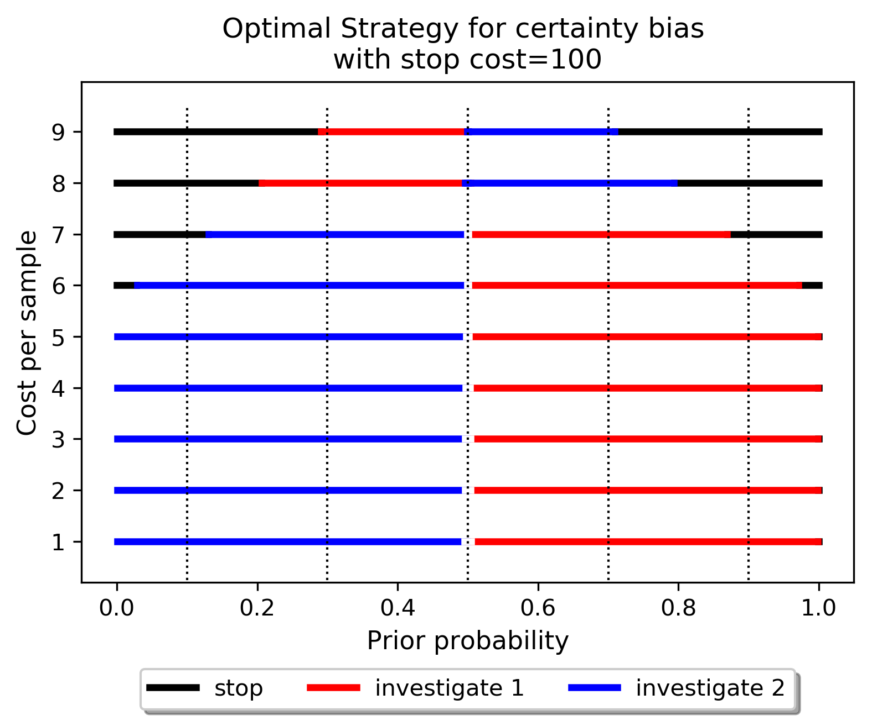
alpha1 = 1, alpha2 = 1, stop cost = 100

